Slide 1
THINK TANK
@HASSfutures

Slide 2
Welcome!
Permissions and program
Definitions
Think tank
Value proposition
HASS education
Purpose and importance
Our intended outcomes
Your intended outcomes

Slide 3
Who’s here?

Slide 4
Introduce yourselves
Where are you from?
What do you do?
When did you engage with a HASS education?
What did you study? Why?
What are you hoping to get out of attending this session?

Slide 5
Where did this come from?

Slide 6
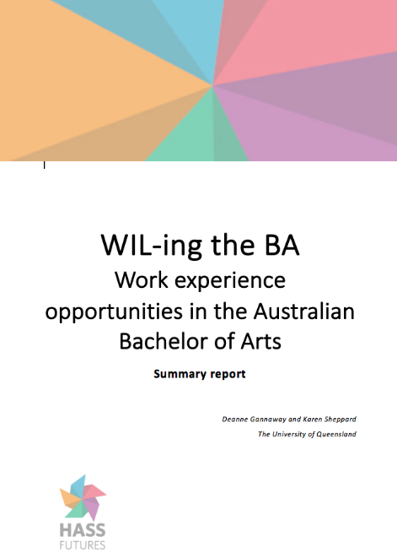
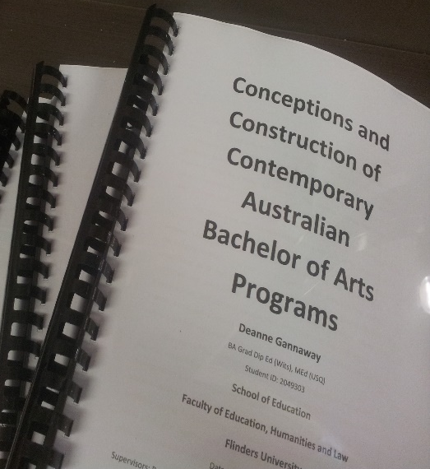
Preceding studies
The Lettered Country (2003)
Nature and Role of BA in Contemporary Australia (2008)
Benchmarking Australian BA programs (2012)
Mapping the Humanities (2014)
PhD study (2015)
WILing the BA (2016)

Slide 7
Fellowship Activities
HASSFutures Think Tanks (April – June)
Institutional, external, virtual
Institutional conversations (May)
HASS Teaching Masterclass Webinars (June – Nov)
BA Conference (25-26 September)
Case studies of HASS Teaching Practice
HASS education research repository

Slide 8
www.hassfutures.org

Slide 9
Spin off projects
Tracking changes in the Australian BA 2013 - 2017
Expectations and anticipations of BA students
Day in the life of a BA graduate
Whole of program approaches
Tracing the evolution of Bachelor of Arts programs from colonial roots

Slide 10
What’s the crisis?

Slide 11
Value of BA
Jobs, Jobs, Jobs
Student numbers
Absence of a clear value statement

Slide 12
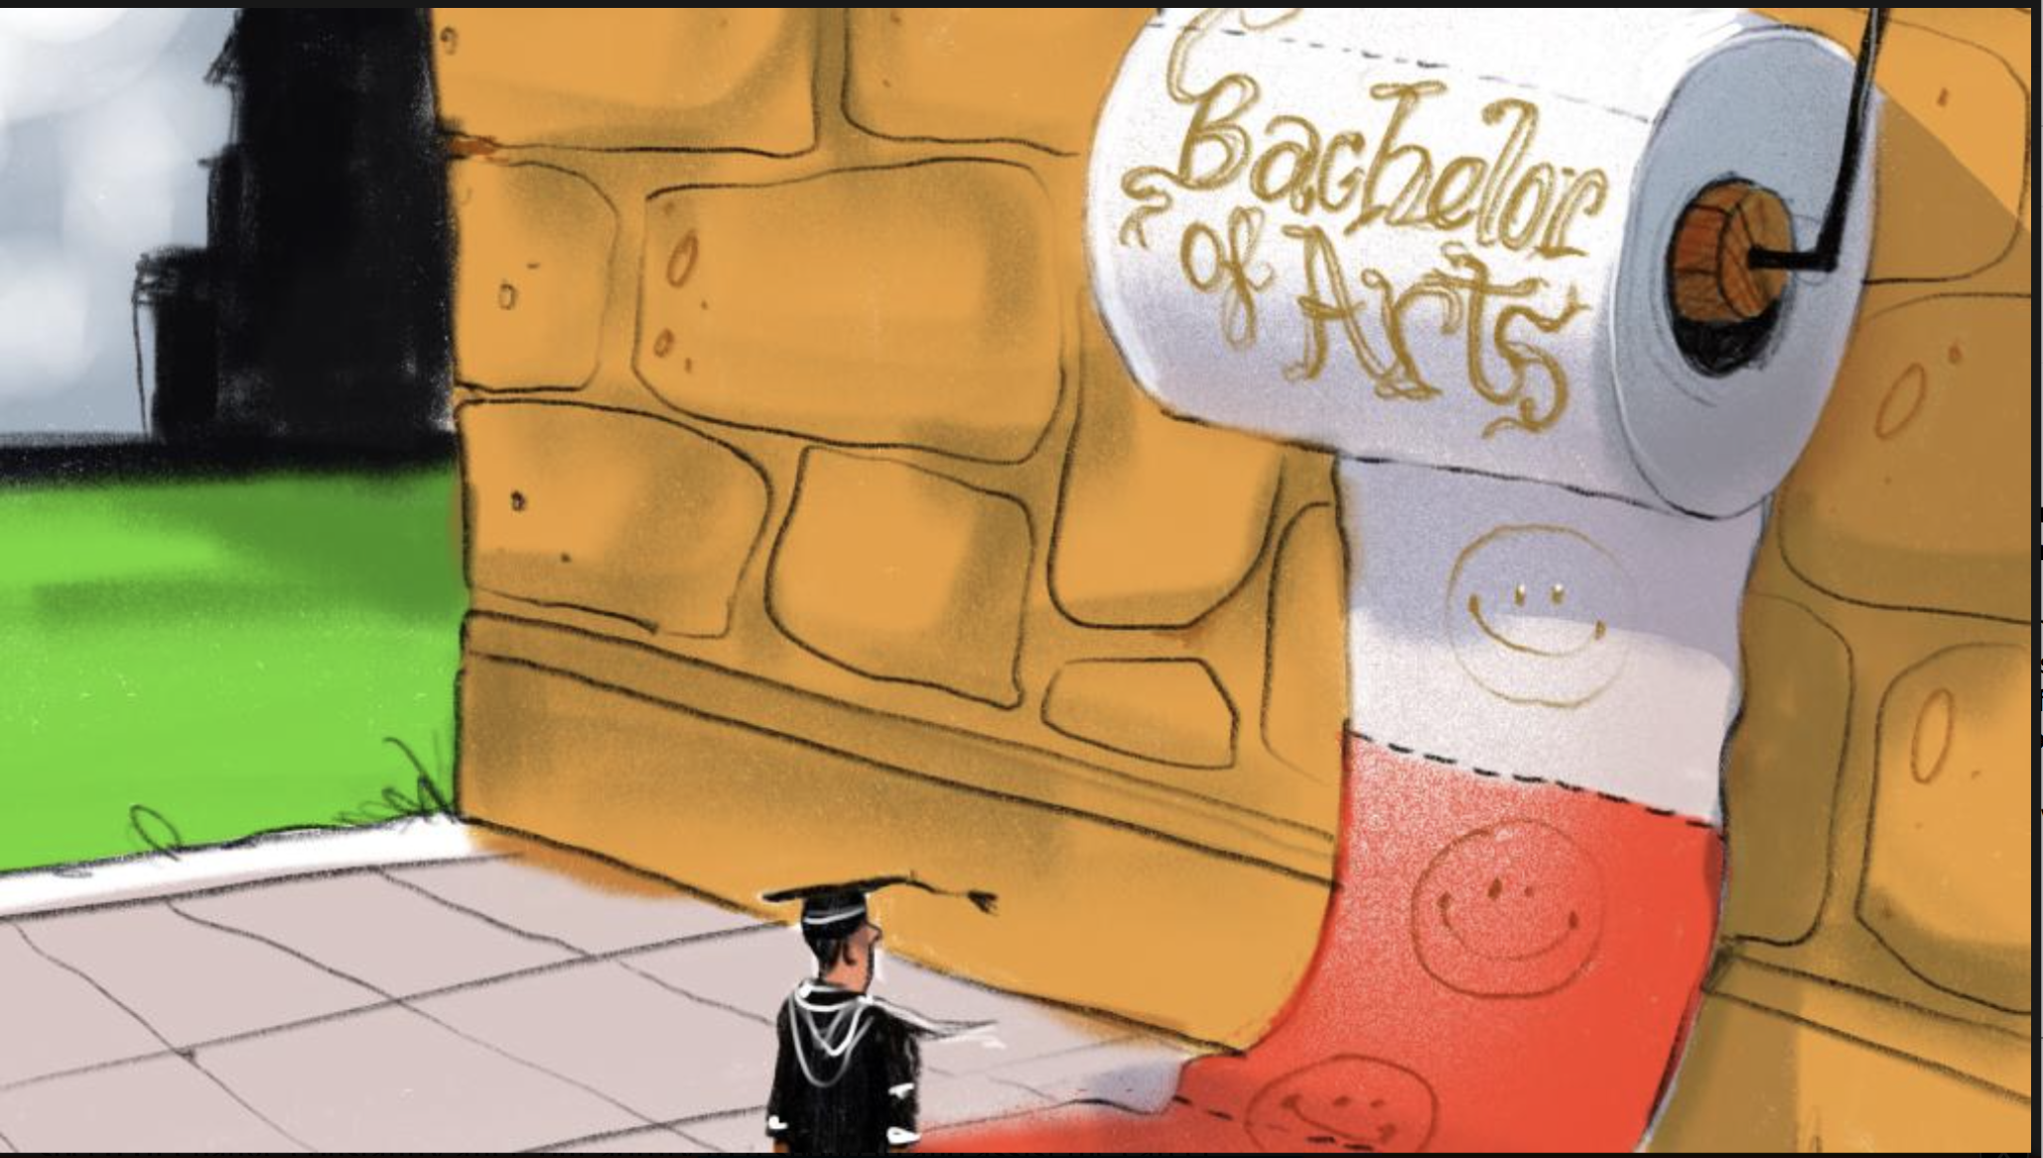
...no degree is more singled out for its lack of responsiveness and relevance than the Bachelor of Arts
http://www.theaustralian.com.au/higher-education/there-has-never-been-a-more-exciting-time-for-the-ba/news-story/d6fb6b62dd04c9da1dcb1bdf578fe295

Slide 13
Challenges and opportunities facing HASS education

Slide 15
One-third of the Australian economy faces imminent and substantial disruption by digital technologies and business models – what we call a ‘short fuse, big bang’ scenario. This presents significant threats, as well as opportunities, for both business and government
Deloitte’s short fuse, big bang report, 2016
Digital disruption

Slide 16
Age of transition
Age of machine - automation
Complex social, environmental, political challenges
Education for uncertain futures
CHALLENGES? OPPORTUNITIES?

Slide 17
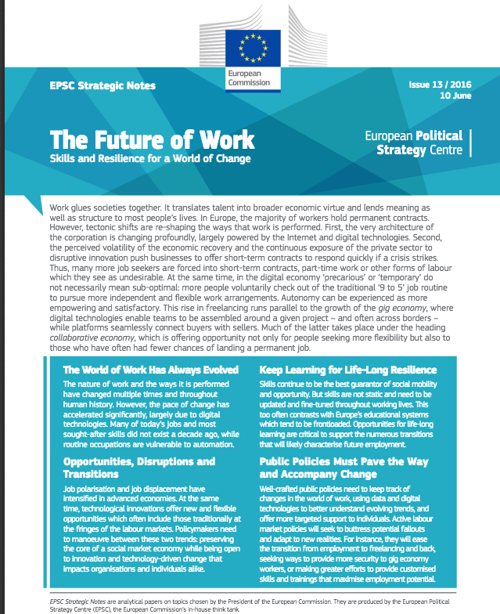
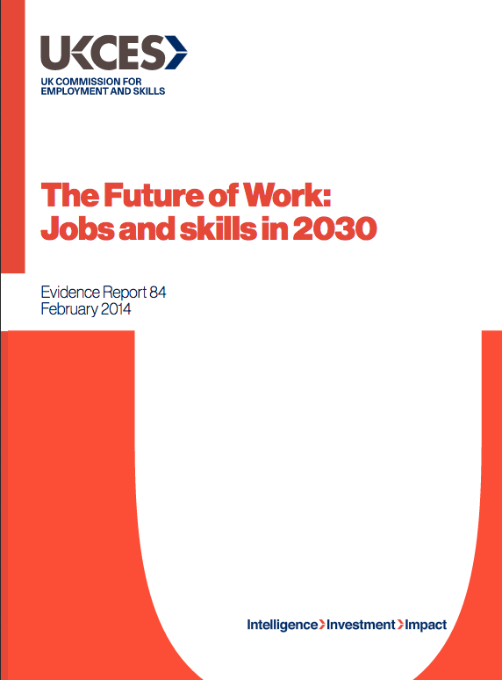
Changing needs/ changing education

Slide 19
“…in Australia there is now widespread agreement about the importance of ambitious graduate capabilities that go beyond technical or disciplinary expertise”
(Probert, 2015, p. 1).

Slide 20
Universities have never turned out graduates who are “job ready” — robots ready to slot into the workplace. Their value proposition is to produce graduates who are “job capable” — experts in their disciplines with the foundations of workplace skills….Let’s abandon the historical expectation that degrees and careers should be tightly linked. Instead, let’s unchain our thinking and embrace the opportunities.
Finkel, Chief Scientist, The Australian 29 August, 2016

Slide 21
Public perceptions of HASS

Slide 23
Emphasis on STEM
STEM
STEMM
STEAM/STEaM

Slide 24
Limitations in Automation
Social intelligence tasks
Creative intelligence tasks
Perception and manipulation tasks
Limitations in STEM

Slide 25
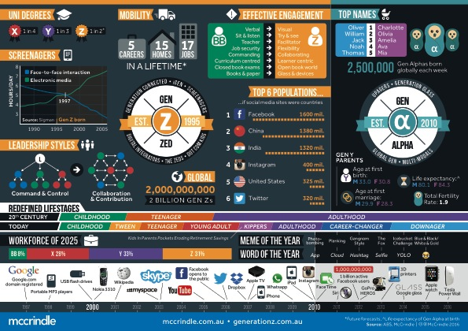
Future students/ future graduates
Gen

Slide 26
In the past, students graduated, receiving documentation of their record of knowledge, skills and experience acquisition. Individuals then packaged these and presented them to potential employers or civic organisations in the hope they would be hired. Employers then spent considerable time sorting through such materials to find the right person to hire. Graduates expected that their academic portfolio including diplomas, resumes, micro-credits and similar credentials provided the stamp needed to gain entrance into the labour market.
Today, employers establish the criteria they are looking for and rapidly sort through larger databases of potential employees to determine from whom they wish to receive additional information via, for instance, interviews. Now, the new system rapidly scans for employer needs so the traditional portfolio becomes support and validation rather than a ‘ticket’ for entry.
The jobseeker of the past will now become the sought.
Changing employment
Image credit: iqoncept / 123RF Stock Photo

Slide 27
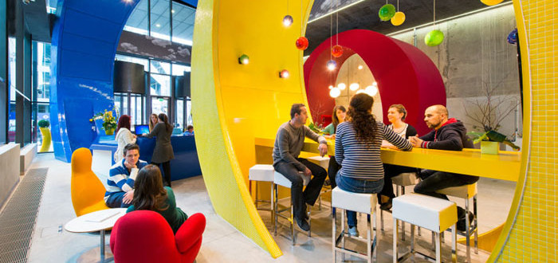
Job “capable”
Agile, flexible
Educated for uncertain futures
Problematize complex situations enabling innovative solutions
Globally adept
Interdisciplinary translators
Creators and generators
HASS education’s current message
Critical thinking
Communication
Discipline knowledge
Collaboration
Ethical perspectives
Cultural understanding

Slide 28
HASS Education – a new potential

Slide 30
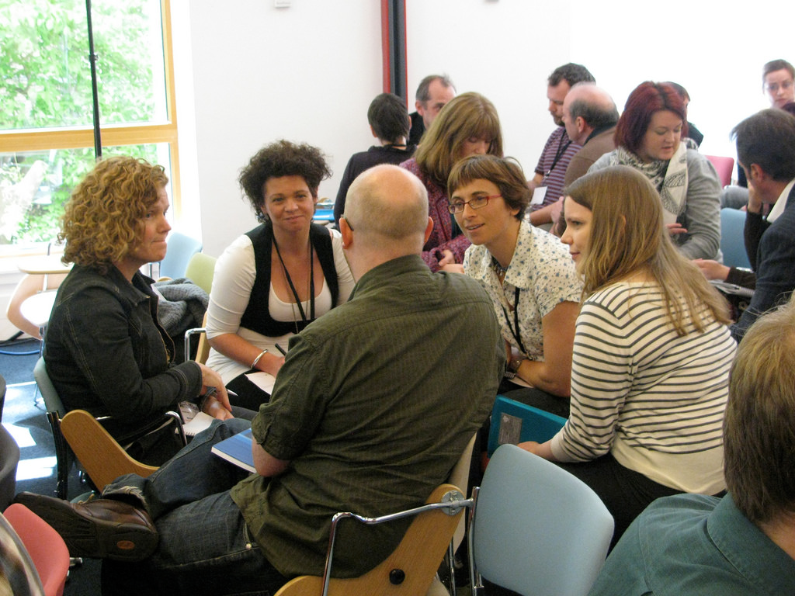
Group discussion
What graduate outcomes should HASS education produce?
Where could HASS graduates go?
What can HASS education bring to a new age?

Slide 31
A contemporary value proposition for HASS education

Slide 32
Educational Philosophy
Return on Investment
Telos

Slide 33
Communicating value
Who do we need to tell?
What do we need to tell them?

Slide 34
Where to next?

Slide 35
What do we need to shift the narrative? Recommended actions from this group? What should we be saying to peak bodies? (and who are they?)

Slide 36
Stay in touch
Dr Deanne Gannaway Australian Learning and Teaching Fellow
Institute for Teaching and Learning Innovation
University of Queensland
07 336 52890
d.gannaway@uq.edu.au
HASSfutures.org

