Slide 1

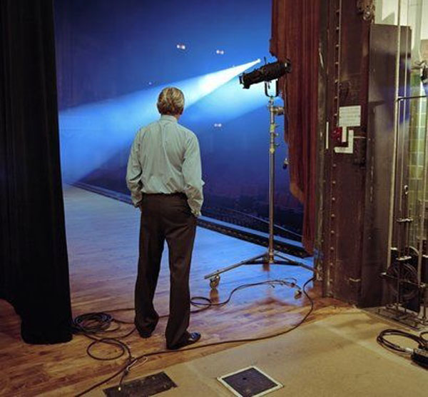
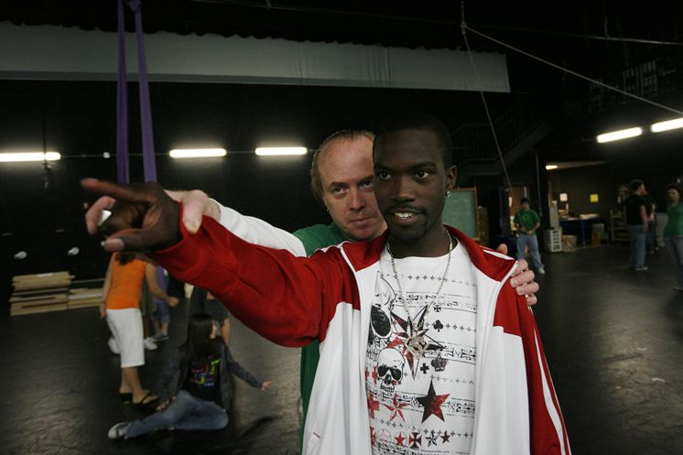
Reimagining HASS pedagogies – from sage on the stage to director in the wings
Dr Genevieve Hundermark
University of the Witwatersrand

Slide 2

Overview
What is EBL?
Why EBL?
How does EBL contribute to a reimagined HASS pedagogy?
What demands does EBL place on students and facilitators?
What EBL facilitators say about the programme…

Slide 3

What is
Based
Learning?

Slide 4
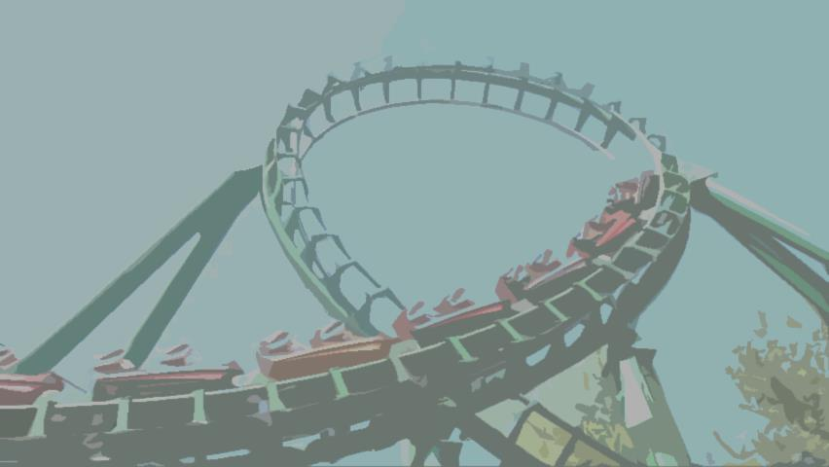
Facilitated, reiterative, closed-loop learning
Case study based
3 questions:
  What do we know?
  What don’t we know?
  What do we need to find out?
2 rules:
  Everyone is present
  Group processing
Learning process is focus – evaluation is secondary
Notes:
And why?
Why – pilot project; at-risk students, failing 2 or more of 4 courses. Sessions held – 2 sessions of 1.5 hours each
Course has shown results in assisting students to develop skills needed for higher education studies. Collaborated with Commerce faculty to offer to at-risk students. Encouraged to participate by advisors, but students self-selected.
Small group based – 8 students and 1/ 2 facilitators
Evaluation: individual case study to be completed 30%; group member evaluation 70%
Evaluated on 10 point scale for 4 areas: reasoning skills, knowledge and use of resources, communication and group skills, evaluation and assessment skills

Slide 5

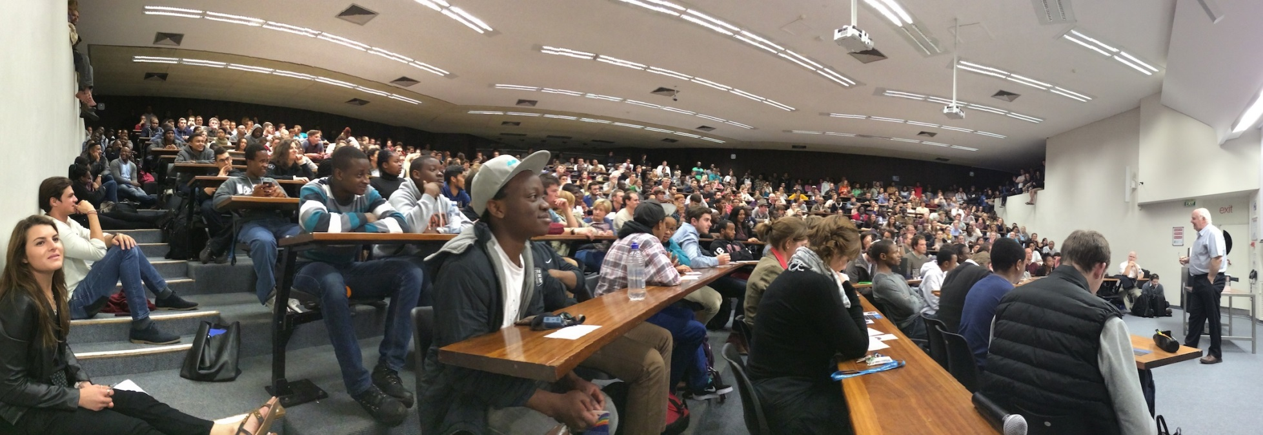
Current HASS pedagogy
Notes:
EBL different model to what is taking place in undergraduate classes at Wits
Small-group based, facilitated. More personal and intimate
Most classes at Wits 150 to 400; large class, massification, students lost and overwhelmed, no one cares
Instructivist approach, unless technology is incorporated for feedback mechanism

Slide 6

EBL = reimagined HASS pedagogy?
Activity theory
Experiential learning theory
Social constructivism
Self-directed learning
Collaborative learning
Pedagogy of the oppressed? (Wits/SA context)
Notes:
EBL – facilitated, reiterative, closed-loop approach but has many learning theories underpinning it. Happy to discuss afterwards.
Implication is that different types of students are considered and likelihood of their learning style preference being catered for is strong. Focus is on social and activity/experience, while being able to be self-directed, and at the same time finding your voice.

Slide 7

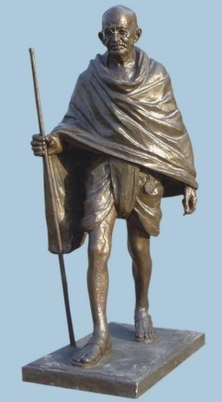
ADED1005 (Power, Bodies & History) menu
You’re too sweet
Is a sugar tax the best way of dealing with South Africans getting increasingly fat and unhealthy?
Bronze, Stone and Reputations
Why is a statue of Mohandis Gandhi to be relocated, citing reasons that he is a controversial figure?
What is the value of memorials?

Slide 8


Killing my People
The Ogoni people are experiencing severe atrocities and are being exploited at the hands of big business. Why is this so? What can be done?
It’s a jungle out there!
The sleeping lion was stolen – for less than a song! This case covers the history of a world-famous song with African roots, challenges experienced in the music world, and the rights of music ownership.

Slide 9


Whatsapp – Are we blind?
Hunger and world hunger is still an issue when access to food has increased. Why?
Hell and other destinations
Pro-life or pro-choice? Apply your thinking to situations where ethics and personal choice are in opposition to law.

Slide 10
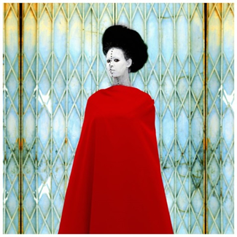
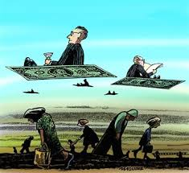
What lies behind the mask?
This case study focuses on two very interesting scenarios that investigates the construction of culture and factors related to and impacted by this construction.
Is this Just?
This case investigates how societal inequalities impact on justice and what can be done in a South African context.

Slide 11





EBL demands…
Notes:
Time management – have to show up, preferably on time
Reflection through group processing
Students are accountable, responsible, answerable to group
Students have voice and contribute to investigating a problem
Connections are made between pieces of information in response to task

Slide 12

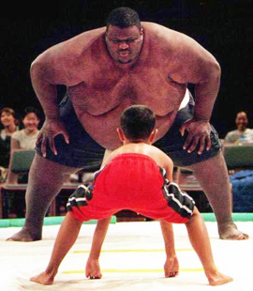


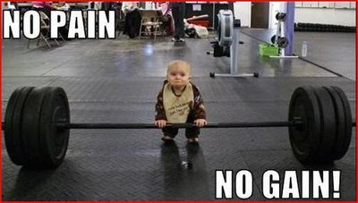
EBL demands…
Notes:
Power differential is minimised
Patience is needed – silence is golden
Interdisciplinary approach
Painful – slow down the learning; give time for students to take back/own power
Facilitator needs to shut up; students need to be quiet to give others a chance to be heard
Painful process

Slide 13

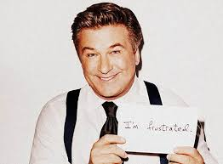

Facilitators’ thoughts and reflections
Notes:
Efficacy – training, writing cases, experience, process, support
Facilitators generally felt that the training and support they received in writing cases was good and effective.
They are enjoying the facilitation experience and process, though most have difficulty switching to the facilitators’ hat, even if experienced previously, and deciding how or when to participate in the group.
Group processing – mostly polite; could relate to unaccustomed to giving and receiving feedback or principle of Ubuntu or still moving through group process – forming, storming, norming, performing
Fake the frustration of late coming or non-attendance

Slide 14



Facilitators’ qualities (?)
Notes:
Facilitators qualities:
Student-centred and focus on process, not product, of learning
Remain curious – be part of group
Be comfortable with discomfort
Facilitators need to be flexible - rescheduling

Slide 15

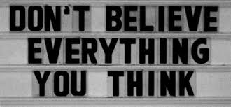

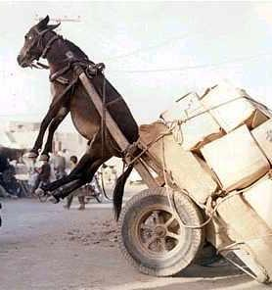
Facilitators’ reflections
Notes:
Facilitators reflections:
Role: Challenge students to question their assumptions – in a gentle, non-threatening way
EBL provides supportive environment and learning communities for students – literature, starting to emerge; facilitators – weekly meetings
Believe EBL should continue – for all students, not only “at-risk”
Concerns over workload if EBL continues

Slide 16
Facilitators’ reflections
“These different understandings of the course made me wonder that if a class of 8 students has different information about the same course, how much more in a big lecture theatre of 450-500 undergraduate students.”

Slide 17
“Group processing was happening parallel to the discussion; students were aware of each other’s behaviours and how it had an impact on the discussion.”

Slide 18
“After this session, we had our facilitators meeting. The main discussion was on non-attendance and late coming.
What hit me during this discussion was why I was upset about students being late.
I think I felt powerless in the new role and environment of EBL.
I was in my lecturer mode in which I would start a class on time irrespective of all students being present. In fact, a lecture would not start even if I was late. Yet in EBL all that power that I had taken for granted all this time was exposed for the privilege that it was. Losing it was upsetting, and yet I could not even recognise it during the moment until I had the chance to process at our facilitators meeting.
It was a humbling experience for me to recognise how, indeed, privilege goes unnoticed even as we defend it with sugar coated arguments such as the ones I made that students were late and may not be taking the sessions seriously.
I was relieved by these thoughts and I also realised that the
pilot was not about students only but me too as the facilitator.”

Slide 19
“…for the first time the class was moving back and forth to the scenario tasks thereby trying to connect every idea to how it helped to answer the question. This was in stark contrast to the first two sessions in which the students only listed the ideas. In today’s session they were linking them…”

Slide 20
“I felt comfortable today; I had neither inner panic nor emotional ‘pacing the floor’ ”

Slide 21
Feedback to facilitator during group processing:
“today the group commented I was more of a facilitator than the last session. My role was effective - taking a back seat and then intervening not to “spoon-feed” students but to help them think more about their discussion”.

Slide 22
“I am feeling happy to attend the session and I leave the session energised and looking forward to the next one. Yet with lectures, 45 minutes are exhausting and I would be counting down towards end of term.”

Slide 23
“The group raptured in laughter but also in amazement at how confident and honest he (student) had been today.”

Slide 24
“This …learning issue is related to power and ‘hidden curriculum’ as I think students are still struggling with the lecturer who knows everything and is using the sessions to trick them and expose their ignorance. There is still little confidence in the group’s attempt to carry on the task without looking at me for approval.”

Slide 25

“For the first time I see how emotions and behaviour contribute towards learning. Most importantly, it is amazing to see how a student can confidently and intellectually grow within a small, supportive and generative group.”

Slide 26
“What I am learning in these sessions is that the EBL process exposes both our learning and behavioural problems to the group and us as individuals.”

Slide 27

“They (students) are still in the mode of pushing the syllabus rather than experiencing and developing their learning process together.”

Slide 28
“What we (facilitators) are also observing is that they (students) are comfortable enough to express themselves either academically or socially.”

Slide 29
“It is fantastic to watch students realise that they have something of value to say and to take ownership of their learning space.”
“They (students) report that they rely on each other for moral support outside the classroom”

Slide 30
“Students responded relatively well to the novel approach EBL requires in class, although there was some pushback (not unexpected).”

Slide 31
“My role in the first week has been a combination of guide, encourager and largely observer as I spent most of the time trying to observe the interactions between the students themselves.”

Slide 32

Potential challenges…
Notes:
Challenge: between facilitators’ approaches – not something that you can control but have to trust process.
Only 2 rules but there has been some deviation with the rules:
Only have class when everyone is present – one group waited for second session of second week to have first class. Decide to hold the class as students and facilitator were becoming demotivated and frustrated
Group processing – entire group to process but in instances only the facilitator processes. On reflection, stated that he and group discussed importance of all participating in processing – related to evaluation of programme where students evaluate each other based on various aspects.

Slide 34

Thank you!
Dr Genevieve Hundermark
Wits University, South Africa
Humanities Teaching & Learning Unit
Email: genevieve.hundermark@wits.ac.za

